Slide 1
Circular Flow Model of the Economy

Slide 2
Introduction
The Circular flow of model shows how money income and products flow in a circular form and how economy works.
The four sectors of economy are combined to make three models for the purpose of illustrating the circular flows of income and expenditure, and of product and money.
Two-sector model including the household and business sectors;
Three-sector model including the household, business and government sectors; and
Four-sector model including the household, business, government and the foreign sectors.

Slide 3
Circular Flows in a Two-Sector Model
The two-sector model consists of only households and firm sectors. It is a simplified model, though unrealistic.
Assumptions:
Households spend their total income on consumer and capital goods produced by the firms. They do not hoard any part of their income.
Firms do not maintain any inventory.
Firms make factor payments to the households as rent, wages, interest and profits.
There is no inflow or outflow of income or of goods and services from any outside source.

Slide 4
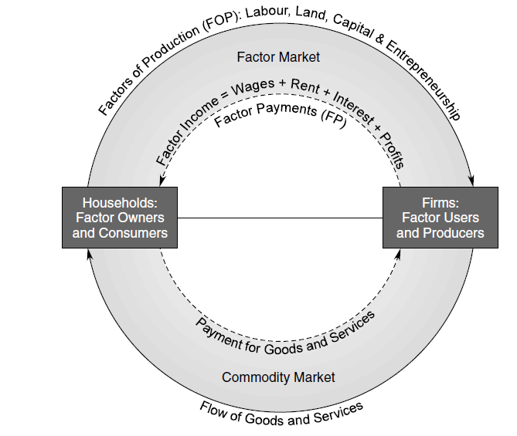
The Circular Flows in a Two-Sector Economy

Slide 5
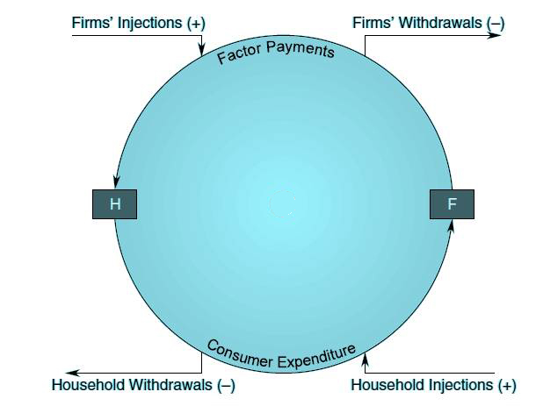
Withdrawals and Injections in the Circular Flows

Slide 6
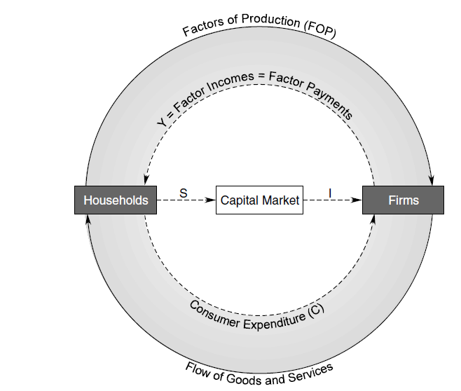
Circular Flows in Two-Sector Model with the Capital Market

Slide 7
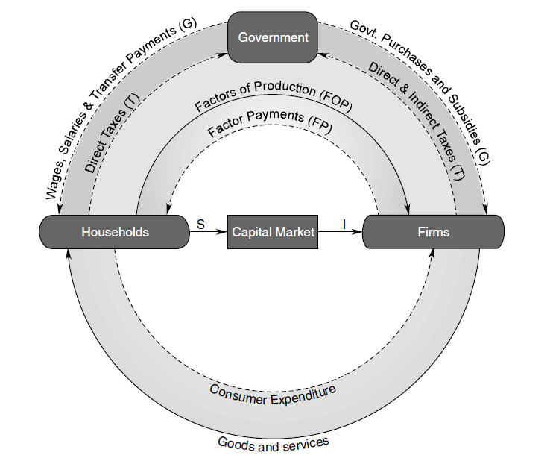
Circular Flows of Incomes in a Three-Sector Model

Slide 8
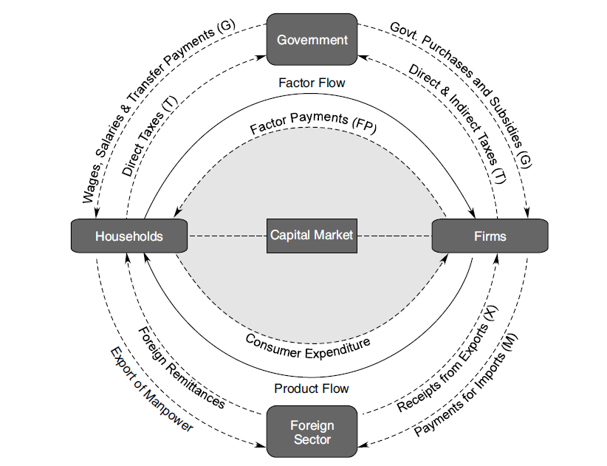
The Circular Flows of Income and Expenditure in Four-Sector Model

